Slide 1
NAnt (Outdated)
Lecturer: Ngo Huy Bien
Software Engineering Department
Faculty of Information Technology
VNUHCM - University of Science
Ho Chi Minh City, Vietnam
nhbien@fit.hcmus.edu.vn

Slide 2

Objectives

Slide 3

Contents

Slide 4

References
Marc Holmes (2005). Expert .NET Delivery Using NAnt and CruiseControl.NET. Apress.

Slide 5
NAnt [1]
https://nant.sourceforge.net/
NAnt is a free .NET build tool.

Slide 6
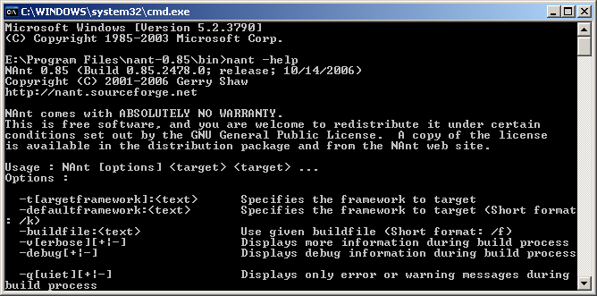
NAnt Core
XML Script
NAnt
Software Build

Slide 7
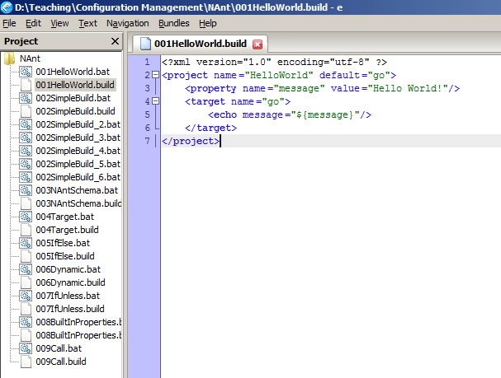
NAnt Script/Build Script/Build File

Slide 8
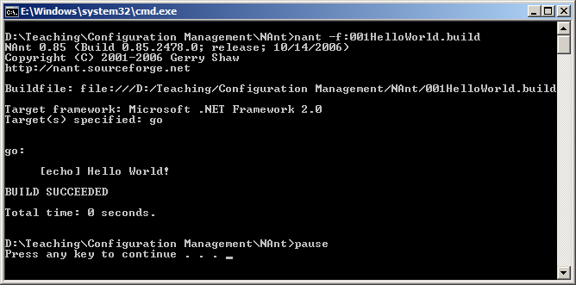
Running Build File

Slide 9
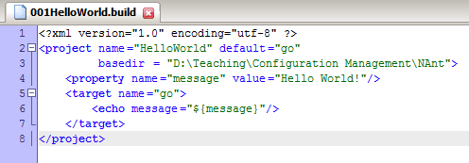
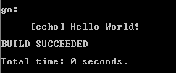
The Project
The root node of a build file
Can contain any number of <property> nodes, <task> nodes, and <target> nodes
One build file has only one Project
Attribute | Description | Required
name | The name of the project. | No
default | The default target to use when no target is supplied. | Yes
basedir | The base directory from which all path calculations are done. Current directory is the default. | No

Slide 10
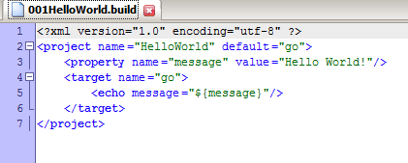
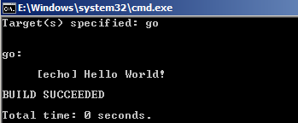
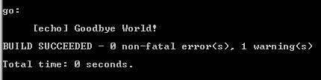
Properties
Properties are key/value pairs described in the build file.
Attribute | Type | Description | Required
name | string | Specifies the name of the NAnt property to set. | Yes
value | string | Specifies the value to assign to the NAnt property. | Yes

Slide 11
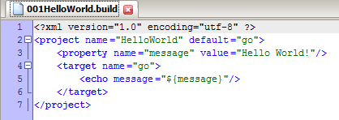
Task
A task is an XML tag inside a NAnt build file that instructs the NAnt executable to perform a specific action.

Slide 12
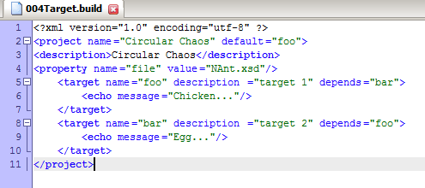
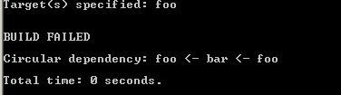
The Target
Target is an XML tag that contains zero or more tasks to be completed in a sequence.
Attribute | Description | Required
name | The name of the target | Yes
description | A short description of this target’s function | No
depends | A comma-separated list of names of targets on which this depends | No

Slide 13
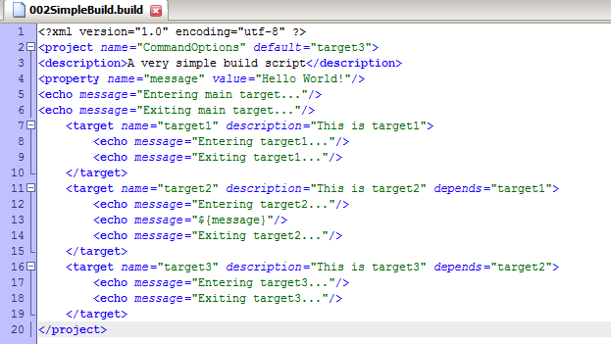
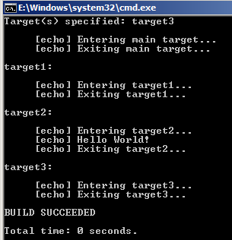
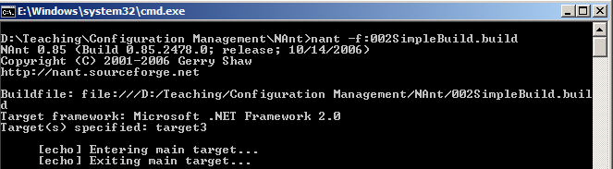
Complete Simple Build

Slide 14
NAnt and Programming Language
NAnt tag | Programming Element
Project | Program
Property | Variable
Target | Method
Task | Statement
Attribute | Parameter

Slide 15
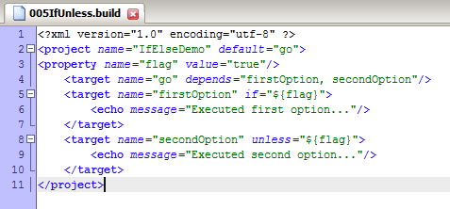
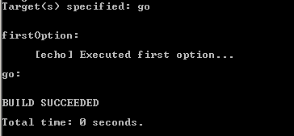
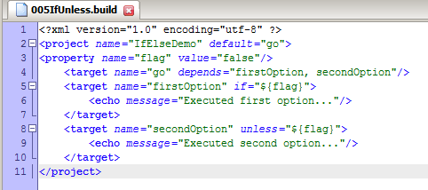
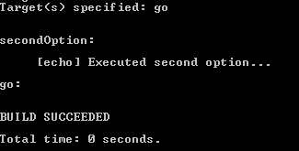
If/Unless

Slide 16
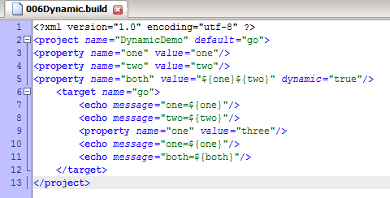
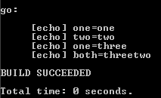
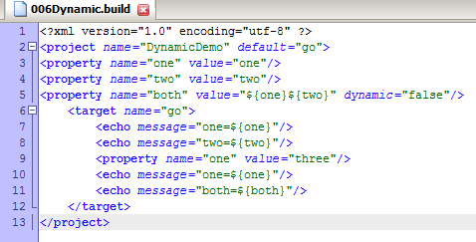
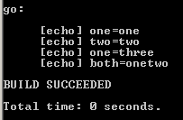
Dynamic Property

Slide 17
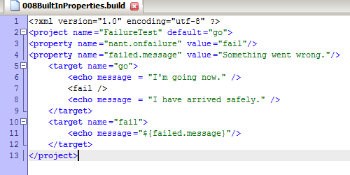
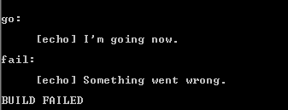
Built-in Properties
Attribute | Description
nant.onsuccess | The name of a target to be executed when the build succeeds
nant.onfailure | The name of a target to be executed when the build fails

Slide 18
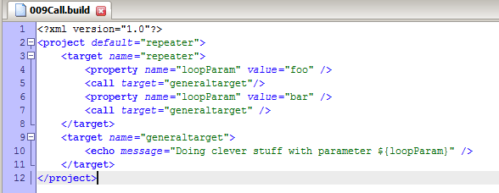
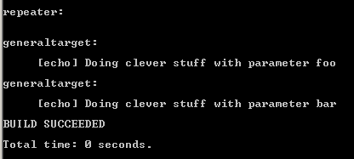
Call

Slide 19
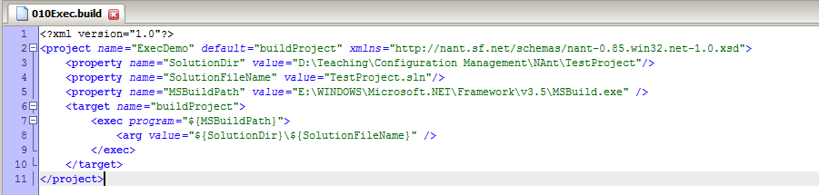
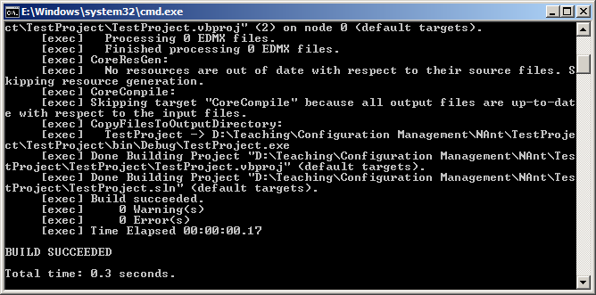
Exec

Slide 20
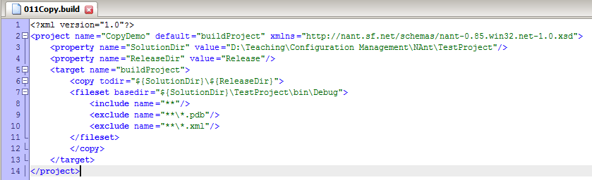
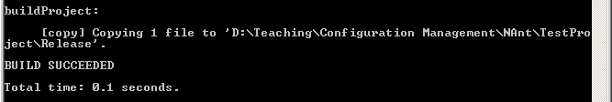
Copy

Slide 21
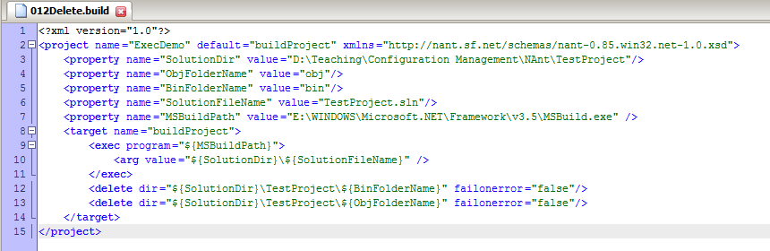
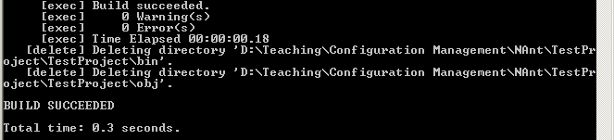
Delete

Slide 22
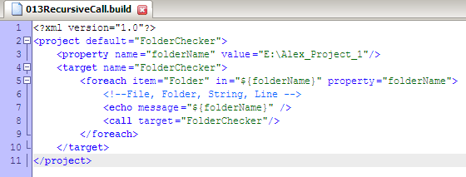
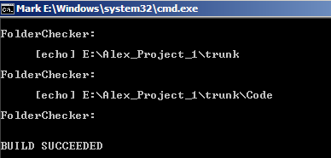
Recursive Call

Slide 23
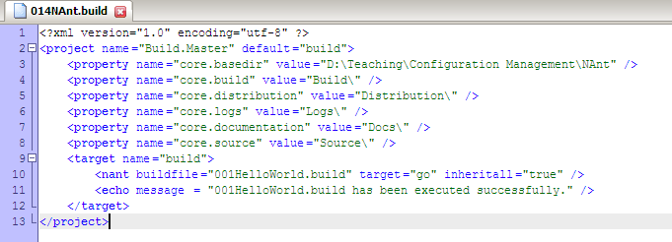
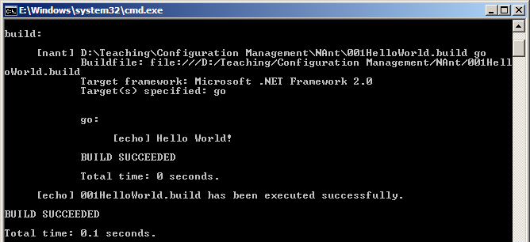
NAnt

Slide 24
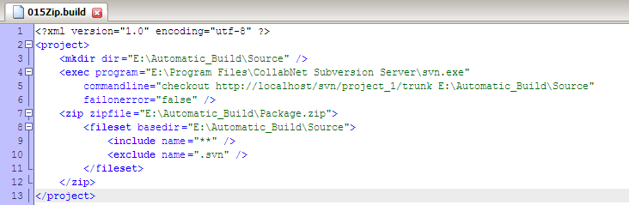
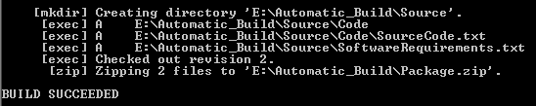
Zip

Slide 25


Slide 26
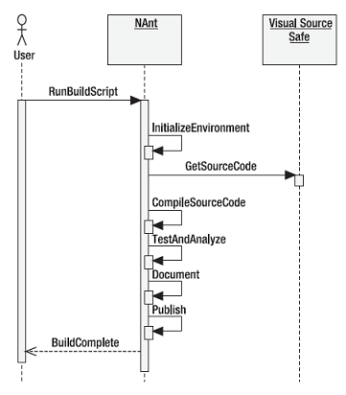
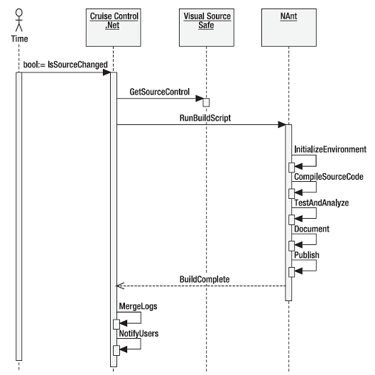
Automated Build

Slide 27
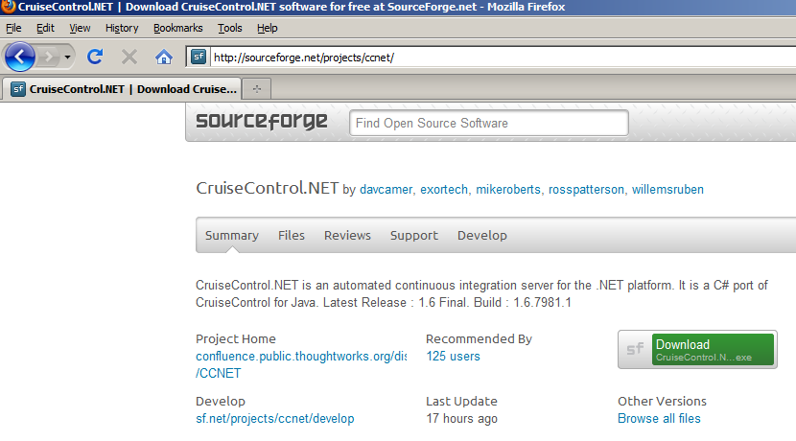
CruiseControl.NET

Slide 28
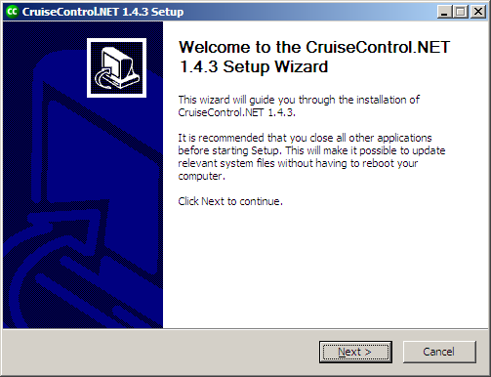
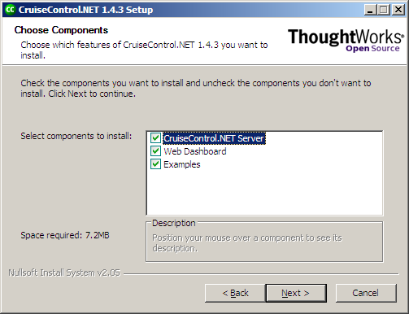
Installation

Slide 29
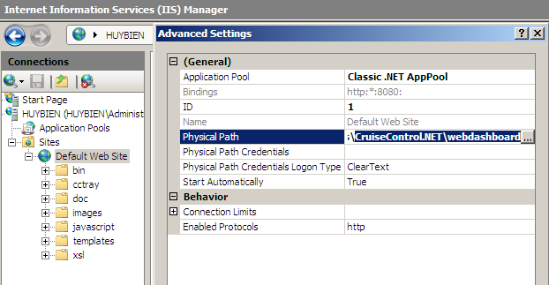
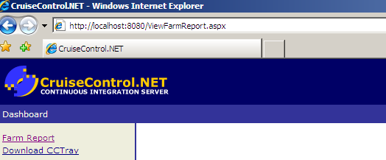
WebDashBoard

Slide 30
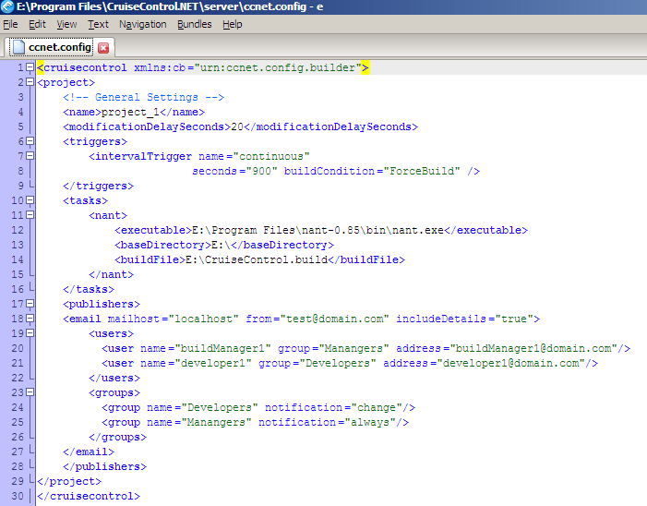
ccnet.config

Slide 31
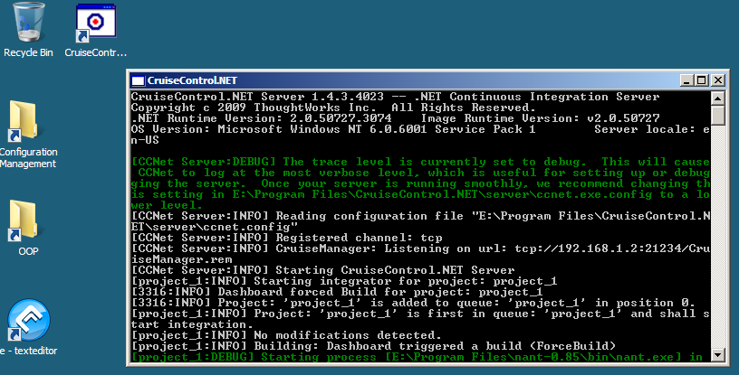
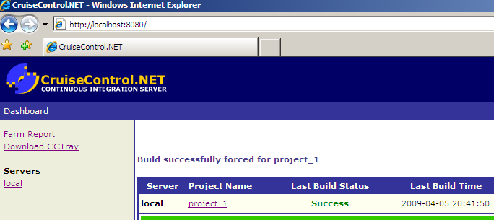
Server

Slide 32
Running a CMD prompt as System
PsExec http://technet.microsoft.com/en-us/sysinternals/bb897553
psexec -i -s cmd.exe
Whoami
RUN CCNET as USER with proper permission to access Certificates to avoid svn error.

Slide 33

Thank You & See You Again

